Slide 1
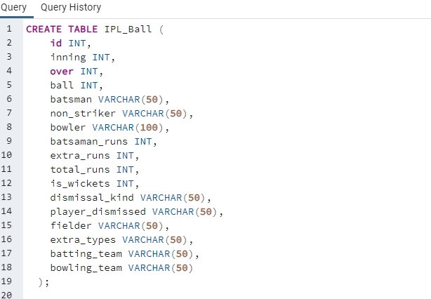
IPL Auction (SQL Project)
1.Query for Importing data from CSV file(IPL_Ball)
2. Copy data from csv file using copy command

Slide 2
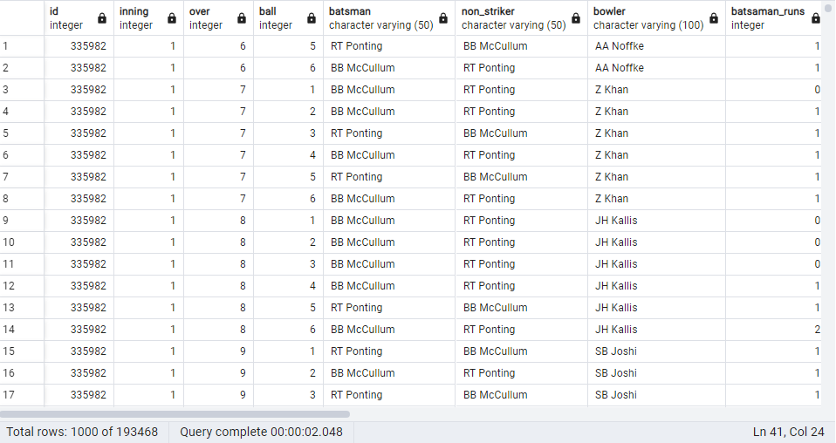
Selecting the imported data IPL_Ball
Query
Sample Output

Slide 3
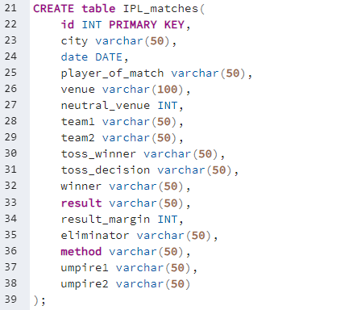
Query for Importing data from CSV file(IPL_matches):
2. Copy data from csv file using copy command

Slide 4
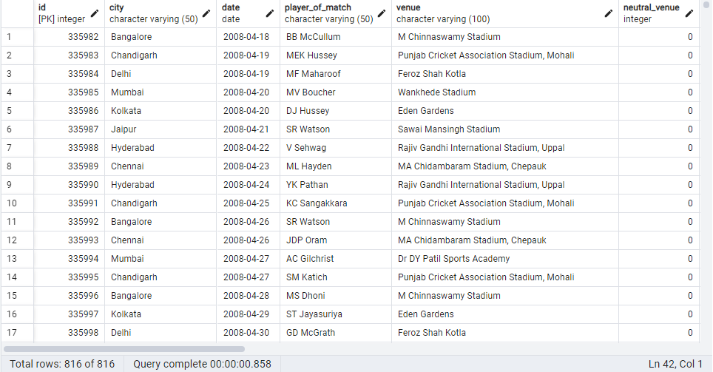
Selecting the imported data IPL_Ball
Query
Sample Output

Slide 5
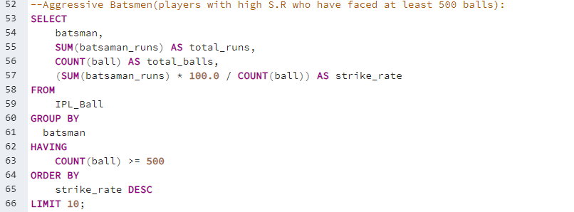
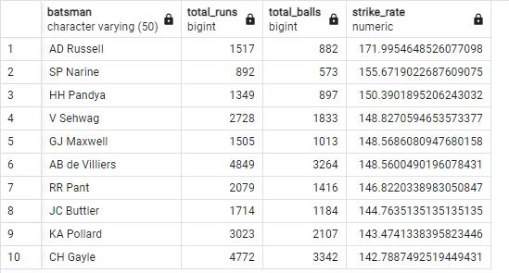
Bidding on Batsman
Aggressive Batsman (Top 10 players with high S.R who have faced at least 500 balls)
Output:

Slide 6
Chart for top 10 aggressive batsman

Slide 7
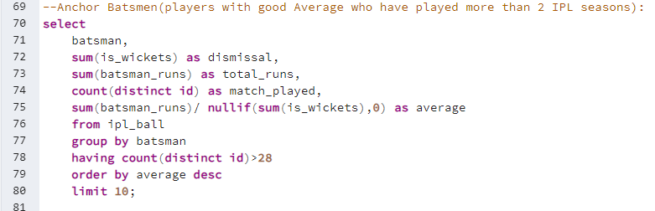
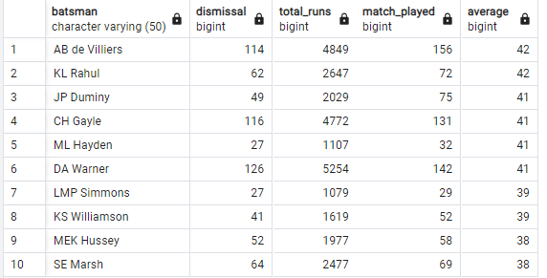
2.Anchor Batsman(Player with good average and who have played more than 2 IPL seasons)
Query
Output

Slide 8
Chart for top 10 Anchor batsman According to output of Query
Chart

Slide 9
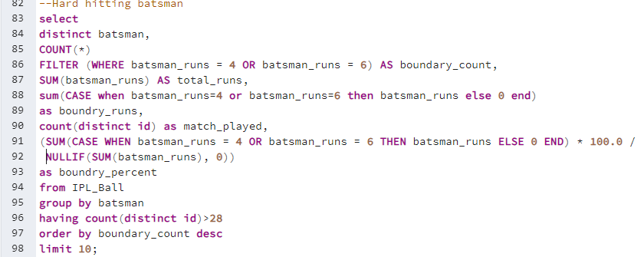
3. Hard-Hitting Batsman (Players who have scored the most runs in boundaries and have played more than 2 IPL seasons)
Query

Slide 10
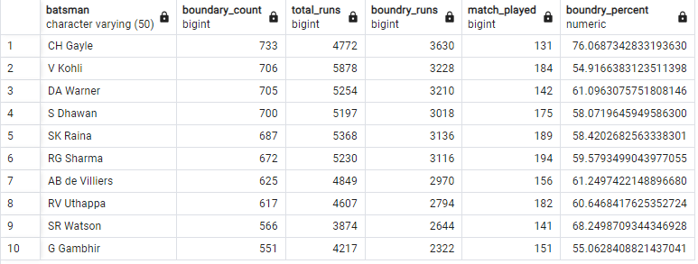
Output of the Hard-Hitting Batsman

Slide 11
Chart for Hard-Hitting Batsman

Slide 12
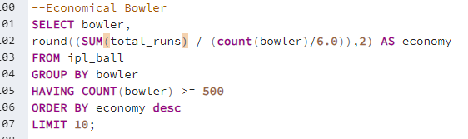
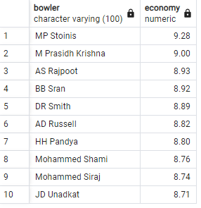
Bidding On Bowler
Economical Bowler (Bowlers with good economy rate and bowled at least 500 balls)
Query:
Output:

Slide 13
Chart for economical bowler who has bowled at least 500 balls with good economy:

Slide 14
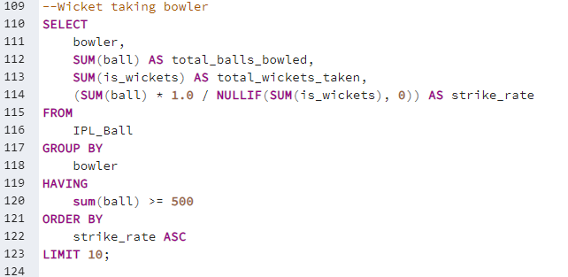
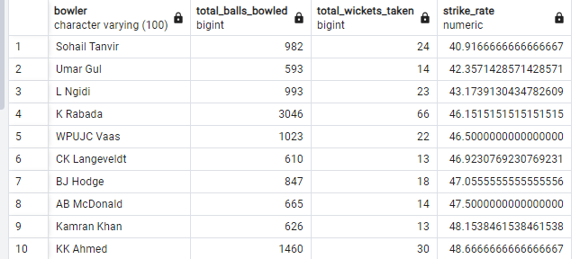
2. Wicket-Taking bowler(Bowler with best strike-rate and bowled at least 500 balls in IPL )
Query:
Output:

Slide 15
Chart for wicket taking bowler

Slide 16
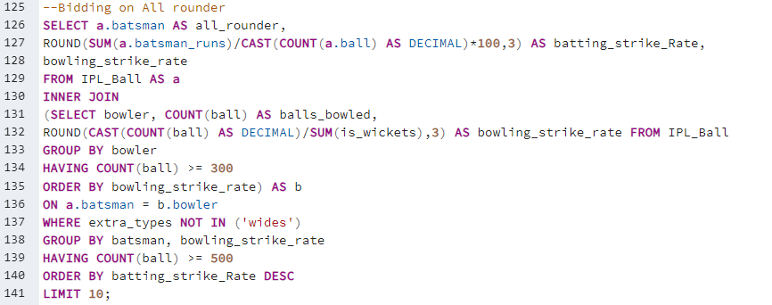
Bidding on All-Rounder (Player with best batting and bowling strike rate & who has faced at least 500 balls and bowled minimum 300 balls)
QUERY

Slide 17
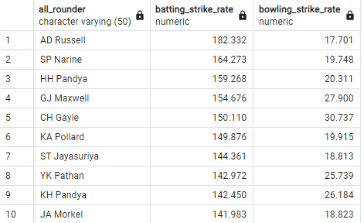
Output for the top 10 all rounder:
Chart:

Slide 18
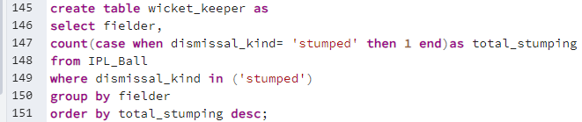
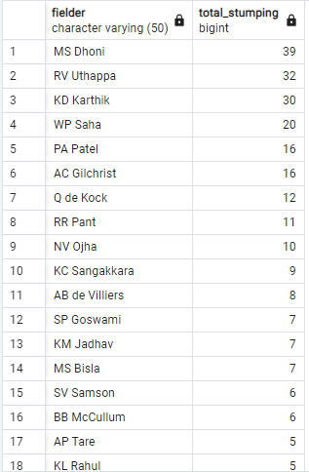
Bidding on Wicket-Keeper
1. Created table wicket-keeper with total number of stumping:
Sample Output:

Slide 19
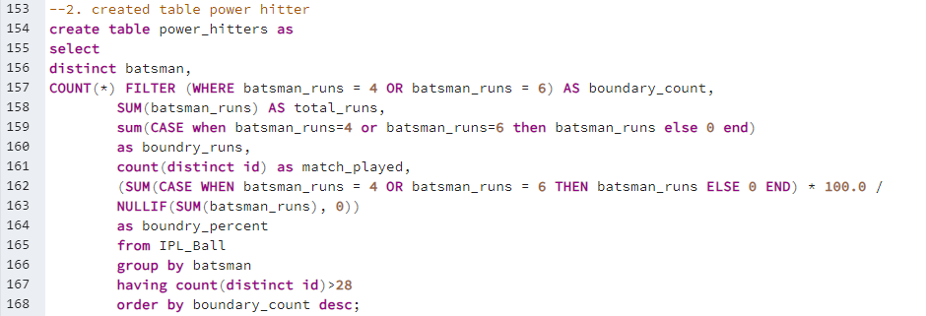
2.Created table Power Hitter(Players who have scored the most runs in boundaries)
Query:

Slide 20
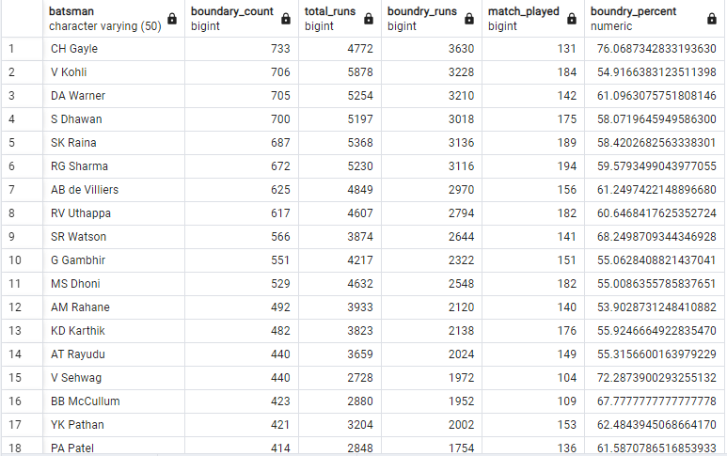
Sample Output of Power-Hitter table

Slide 21
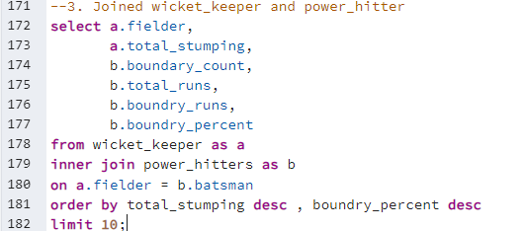
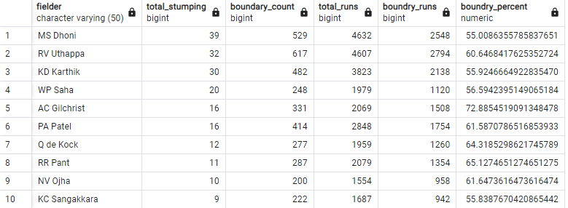
3. Joined wicket_keeper & power_hitters table to get top 10 wicket-keeper
Query:
Output:

Slide 22
Chart
Total Stumping
Runs and Boundary Chart:

Slide 23

Additional Questions
Count of cities that have hosted an IPL match
Query:
Output:
Chart:

Slide 24
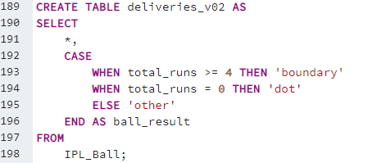
2.Create table deliveries_v02 with all the columns of the table ‘deliveries’ and an additional column ball_result containing values boundary, dot or other depending on the total_run (boundary for >= 4, dot for 0 and other for any other number)
Query:

Slide 25
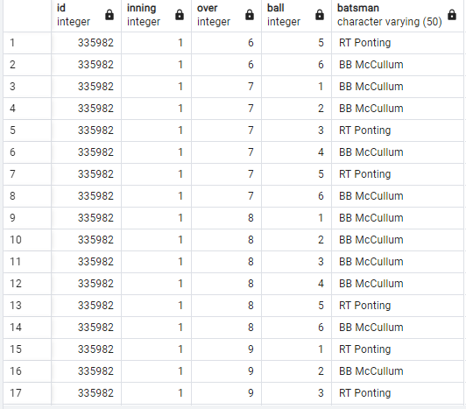


Output of table deliveries_v02

Slide 26
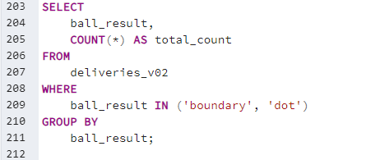

3. Total number of boundaries and dot balls from the deliveries_v02 table.
Query:
Output:
Chart:

Slide 27
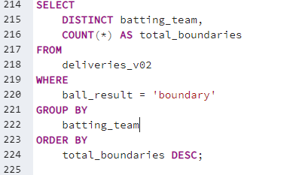
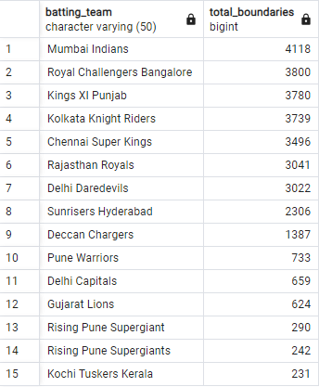
4. Total number of boundaries scored by each team from the deliveries_v02 table and order it in descending order of the number of boundaries scored.
Query:
Output:

Slide 28
Chart of boundaries by each team

Slide 29
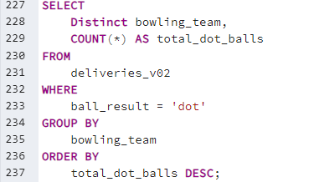
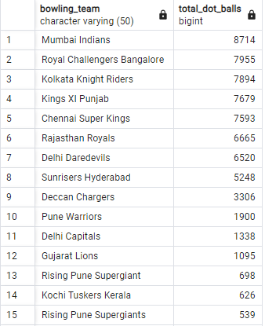
5. Total number of dot balls bowled by each team and order it in descending order of the total number of dot balls bowled.
Query:
Output:

Slide 30
Chart for total DOT ball bowled by each team

Slide 31
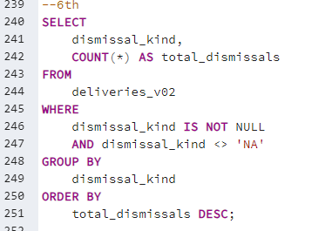
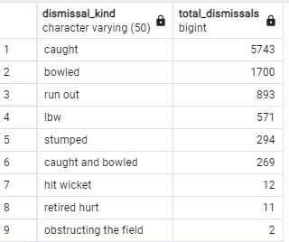
6. Total number of dismissals by dismissal kinds where dismissal kind is not NA
Query:
Output:

Slide 32
Chart of Total number of dismissals by dismissal kinds where dismissal kind is not NA

Slide 33
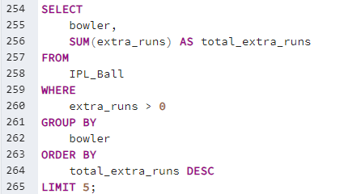
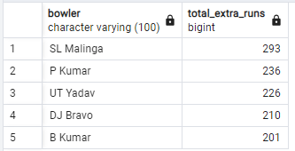
7.Top 5 bowlers who conceded maximum extra runs from the deliveries table
Query:
Output:

Slide 34
Chart of top 5 bowlers who conceded maximum extra runs from the deliveries table

Slide 35
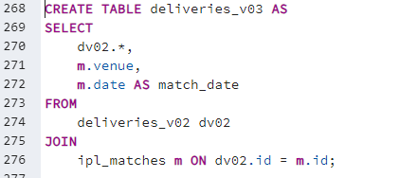
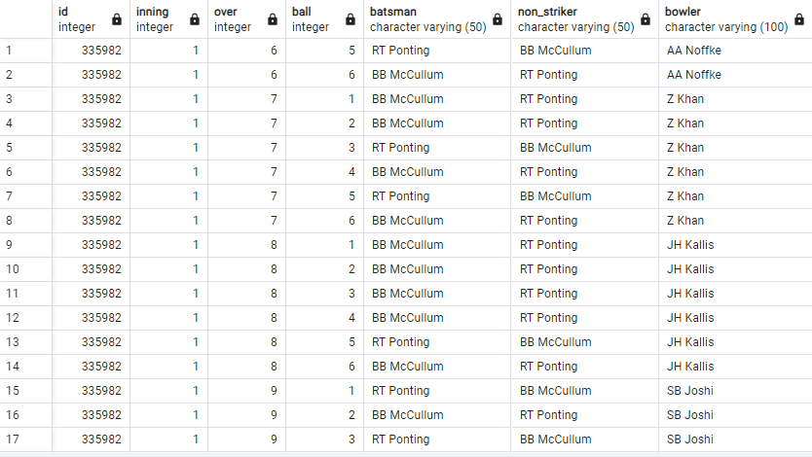
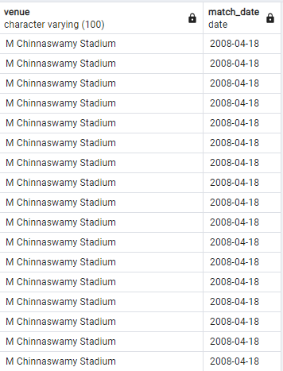
8. create a table named deliveries_v03 with all the columns of deliveries_v02 table and two additional column (named venue and match_date) of venue and date from table matches
Query:
Sample Output:

Slide 36
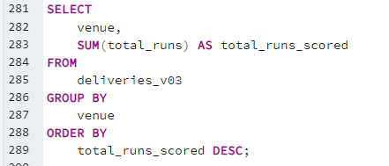
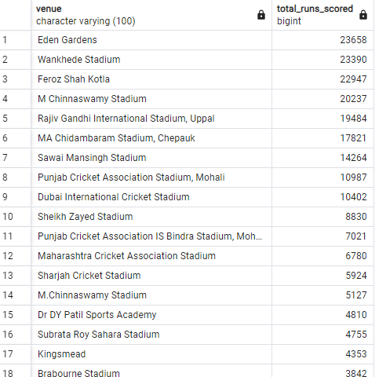
9. Total runs scored for each venue and order it in the descending order of total runs scored.
Query:
Sample Output:

Slide 37
Chart for total runs scored at each venue:

Slide 38
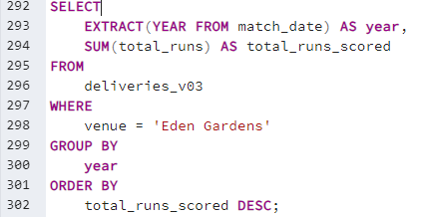
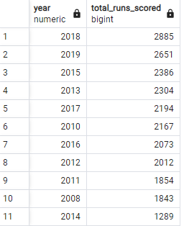
10. Fetch the year-wise total runs scored at Eden Gardens and order it in the descending order of total runs scored.
Query:
Output:

Slide 39
Chart year-wise total runs scored at Eden Gardens and order it in the descending order of total runs scored.

Slide 40


